Slide 1
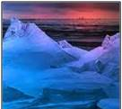
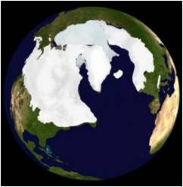
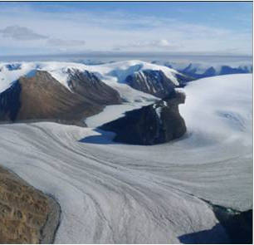
Create your own ice age

Slide 2

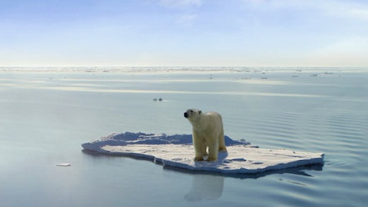
Create your own ice age
You are invited to play God with Planet Earth and doom the planet and its inhabitants to ice age conditions –
but do you know how to do it?

Slide 3
Background
Global climate and the amount of heat received by the Earth from the sun is influenced by 3 main orbital parameters – (so called ‘Milankovitch cycles’)
Eccentricity – influences the shape of orbit around the Earth – varies between circular and elliptical – this change occurs over a 96 ka period – its regulates the amount of heat received by the Earth - nicknamed ‘orbit’
Obliquity – influences the tilt of the Earth as it orbits around the sun – ranging from 21-24 deg over a 42 ka period – this regulates the distribution of heat around the globe - nicknamed ‘tilt’
Precession – the gravitational pull of the moon on the watery planet causes the Earth to ‘wobble’ on its axis as it orbits the Earth causing the seasons to move around the sun over a 21 ka period – this means that it ranges from the winter being closest to the sun (apehelion) and then 21 ka later the summer is closest to the sun (perihelion) and also regulates the distributions of heat around the globe – nicknamed ‘wobble’
These are combined to produce a complex pattern of variable heat exchanged between the sun and the Earth – certain combinations will bring about an ice age
Skip background

Slide 4
Your Mission
Play with these parameters until you have worked out which extent of each parameter creates the least heat for the Earth – i.e., would it be cooler when the orbit is circular or elliptical?
Then set the parameters using the sliding scale to try and create an ice age in the least number of attempts
Play eccentricity
Play Obliquity
Play Precession

Slide 5
Create your own ice age
Eccentricity
0 0.005
circular
elliptical
Obliquity
21.39 24.36
Low angle
High angle
Play
Precession
0 0.07
N hemi perhelion
N hemi aphelion

Slide 6
Play video

Slide 7
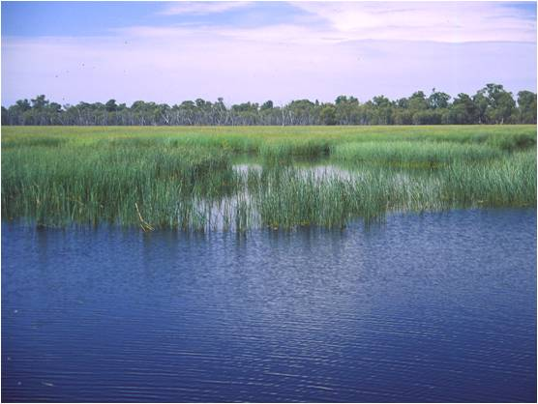
Resulting end screens
You created a
interglacial |  | interstadial |  | stadial |  | glacial
You need to rethink your ideas regarding which conditions would produce the greatest cooling – then have another go
Start again

Slide 8
Resulting end screens
You created a
interglacial |  | interstadial |  | stadial |  | glacial
You need to rethink your ideas regarding which conditions would produce the greatest cooling – then have another go
Start again

Slide 9
Resulting end screens
You created a
interglacial |  | interstadial |  | stadial |  | glacial
You need to rethink your ideas regarding which conditions would produce the greatest cooling – then have another go
Start again

Slide 10
Resulting end screens
You created a
interglacial |  | interstadial |  | stadial |  | glacial
You need to rethink your ideas regarding which conditions would produce the greatest cooling – then have another go
Start again

Slide 11
Resulting end screens
You created a
interglacial |  | interstadial |  | stadial |  | glacial
You need to rethink your ideas regarding which conditions would produce the greatest cooling – then have another go
Start again

Slide 12
Resulting end screens
You created a
interglacial |  | interstadial |  | stadial |  | glacial
You need to rethink your ideas regarding which conditions would produce the greatest cooling – then have another go
Start again

Slide 13
Resulting end screens
You created a
interglacial |  | interstadial |  | stadial |  | glacial
You need to rethink your ideas regarding which conditions would produce the greatest cooling – then have another go
Start again

Slide 14
Resulting end screens
You created a
interglacial |  | interstadial |  | stadial |  | glacial
Congratulations!!!
You achieved an ice age in only 2 attempts

Slide 15
Second stage for people finding it too easy – using data from real glacial – stage 6 190ka
Why do the parameters not fit the pattern exactly?
Can you think of any other factors that could be influencing heat distribution around the globe?
Could we use Milankovitch cycles to predict future climates??

